Slide 1
KAVACH- Radio Frequency Identification
BY
M. Muni Kumar, IRSSE-06
Director/S&T/COE/Kavach/IRISET
7569756418, mmktcas@gmail.com

Slide 2
RFID Introduction
RFID Tags shall be fitted on track in station section, point zones, near Signals & track in block section for giving Trackside information to Loco TCAS unit.
RFID Tags at all the places shall be duplicated with identical information related to operations.
Each Loco KAVACH unit shall have two RFID READERS
When Loco KAVACH unit RFID reader passes over RFID tag, RFID tag shall transmit the programmed data to RFID reader.
Loco unit shall act as per the information received from even one RFID tag out of duplicated tags.

Slide 3

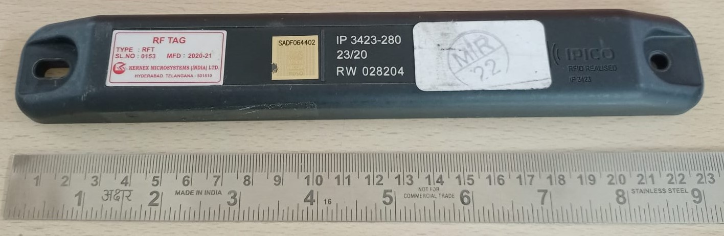
RFID Fixing Arrangement Guidelines
The RFID tags shall be fitted on the sleepers between the rails as per guidelines.
RFID tags shall be fixed at the center of PSC Sleepers
The normal spacing of RFID tags will be about 1 Km.
No holes shall be drilled in the Sleepers and the arrangement of fixing must be through clamps only.

Slide 4
RFID Fixing Arrangement Guidelines
While deciding the location for RFID installation following aspects shall be kept in view:
RFID tags & fixtures shall be avoided in turnout portion in general.
The installation of RFID tag & fixture should be avoided at locations susceptible to ballast accumulation at the center of sleeper such as level crossing etc.

Slide 5
RFID Introduction
RFID tag shall be as per following specifications:
Suitable for reliable working at train speed up to 200 KMPH.
Frequency of operation : 865-867 MHz
Can be programmable with minimum 128 bits of user data.
Shall be able to work even when submerged in water up to rail level

Slide 6
Classification of Tags
Sl | Type of Tag | Notation as per placement
1 | Normal Tag | N
2 | Signal Foot Tag | S
3 | TIN Discrimination/Turn out Tag | T
4 | Gate Tag | G
5 | Exit Tag | X
6 | Adjacent Line tag | L
7 | Adjustment/Junction Tag | A

Slide 7
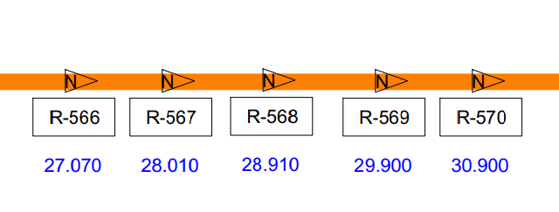
Normal RFID Tags
Normal tags shall be provided in the block section as well as in station section.
The maximum distance between the two normal tags shall not be more than 1000m.
Each Normal tag shall be linked to next two normal tags in both the directions (Nominal & Reverse).

Slide 8
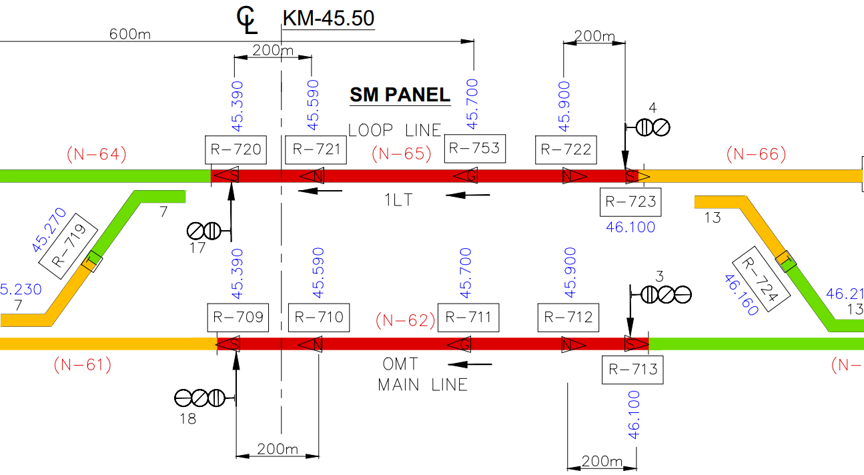
Signal foot Tags
Signal foot tags shall be provided at foot of every signal post.
Every Main signal, Subsidiary signal, Stop board, Ends of berthing track (may be with shunt signal sometimes) and BSLB shall be provided with Signal foot tag.
S-tag shall be provided at the Yard Exit Points not protected by Signals like BSLB etc.,

Slide 9
Tags for Signal Approach
Normal or LC Gate tag shall be provided between 150-250 meters in approach to all Main Signals (Preferably 200 meter).
The distance of Signal Approach (Normal Tag/LC Tag) from corresponding Signal Foot (S) Tag should be exact multiple of 1m. This should be invariably ensured during installation and verification at site.
The minimum distance shall be reckoned as 120 m for Advanced Starter or Intermediate Starter.

Slide 10
TIN Discrimination/Turn out Tag
TIN Discrimination tags shall be used to indicate change in the TIN of track section. Normally it will be placed at turnouts.
To demarcate TIN sections, TIN discrimination Turnout tags i.e. TIN demarcation Tag, Normal tag, and Signal foot tag shall be placed as per the feasibility.

Slide 11
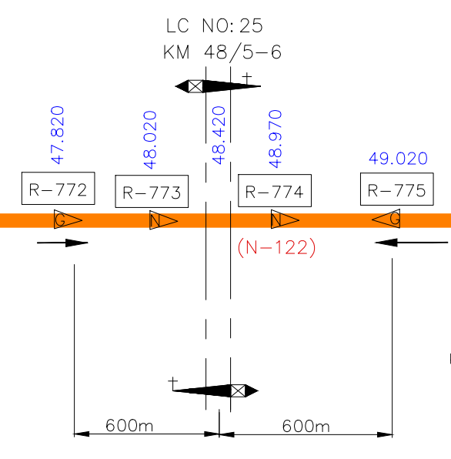
RFID Tags
Gate tags shall be placed at such a distance that Auto whistling for approaching LC gate can commence from at least 600m or W/L board on ap-proach of LC gate.
Adjustment/Junction tag shall be provided, wherever required, to adjust the absolute location in the block section and at the junction stations to correct the absolute location.

Slide 12
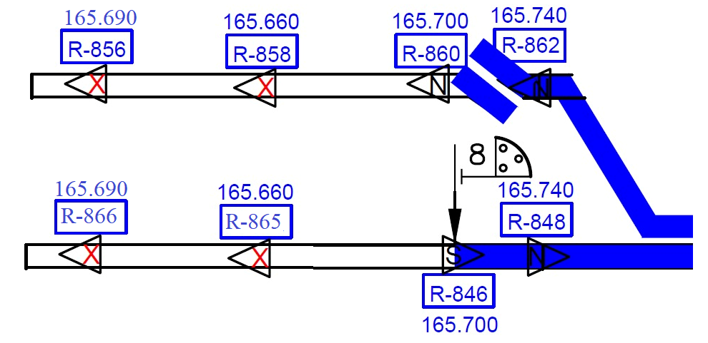
Exit tags
While moving from KAVACH to non KAVACH territory Exit tags shall be provided at the exit boundary of Stationary KAVACH in KAVACH territory.
At all places, where the train is likely to move outside KAVACH territory or remain stabilized for long duration for e.g., sidings, Exit tags shall be pro-vided.
Minimum 2 sets of Tags shall be provided as exit tag.
The 1st Exit RFID shall be programmed with Communication in Direction of entry & no communication in direction of exit and 2nd exit Tag shall be programmed with no communication required in both directions.
Exit Tag may be provided at a distance of 20m.

Slide 13
RFID Tag Layout Guidelines
RFID tag-TIN layout shall be prepared with Signal Interlocking Plan (SIP) as reference. However, the actual site considerations shall be taken into account prior to its preparation.
A site survey shall be conducted to mark the locations where tags need to be placed
The center of Station Masters panel shall be taken as stations Centre Line for reference purpose.
The duplicate RFID tag shall be installed minimum distance of 3 meter to 5 meter except TIN discrimination/Turn out RFID tag. The TIN discrimation turn out RFID tag shall be in same absolute location.
The minimum distance between Tag set (Main & Duplicate) to Tag set (Main & Duplicate) shall be greater than 10 m.
Repeated Tag ID is not allowed within area of 25 Kilometer radius.

Slide 14
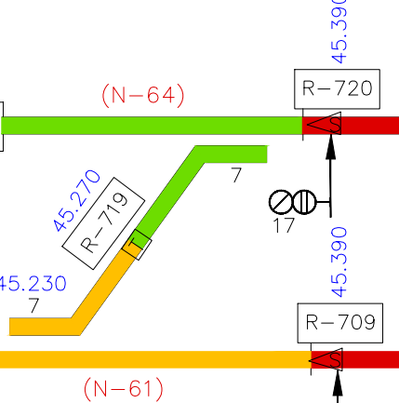
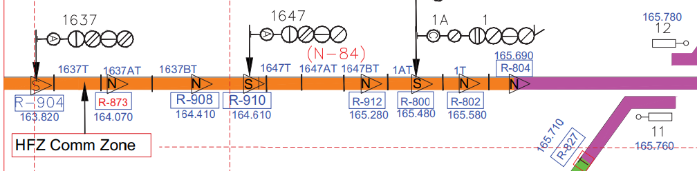
RFID Tag Layout Guidelines
Tag legend in RFID TIN Layout
Legend in rectangle to be used when Main Tag and Duplicate Tags contain same location.
Legend in triangular to be used when Main Tag and Duplicate Tags contain different location. The duplicate tag shall be placed ahead of main tag in the direction of Tip of the Triangle.
Block Section TIN should be extended up to BSLB on unidirectional lines (such as Double Line) and up to opposite direction Advanced Starter on Single Line.

Slide 15
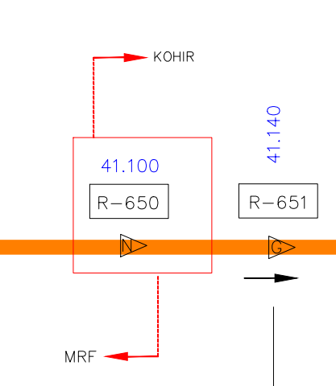
RFID Tag Layout Guidelines
Border RFID tag shall be indicated in RFID Tag layout with absolute loca-tion of station border line. Border RFID tag indicates the maximum dis-tance from where the departed Loco will communicate with previous sta-tion SKAVACH. After crossing Border RFID tag, the loco shall communi-cate only from next stationary SKAVACH. In RFID Layout, the border RFID tag shall be shown as below.

Slide 16
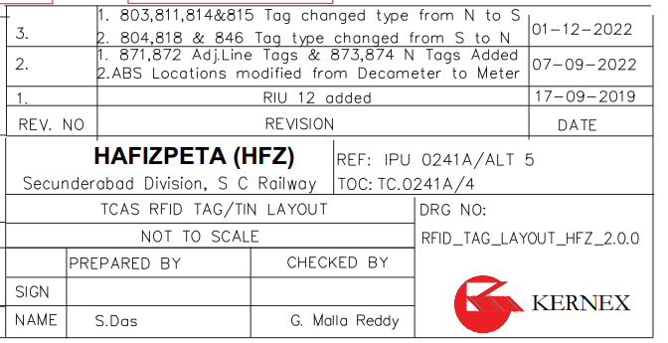
Guidelines for RFID Tag-TIN layouts for the purpose of KAVACH system.
Version Control:- The version control for all documents submitted for approving authority shall have X.Y.Z format in which:-
X means KAVACH Version Control.
Y means SIP version control.
Z means Guidelines change or review comments control.
2.2 Reference SIP drawing numbers shall be mentioned on the layout.

Slide 17
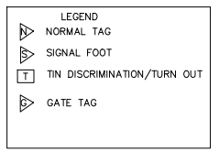
RFID Tag Layout Guidelines
Signature Block and revision history blocks shall be prepared as per the practices of User Railways.
Legends mentioning the notation used for the purpose of preparation of layout shall be specifically mentioned on the layout.
RFID tag-TIN layout need not be up to scale. If the layout is not per scale, the same shall be mentioned on the layout.
Absolute locations of tags, LC gates, signals and turnout switches, BSLB, Stop board shall be mentioned on the RFID layout.
Absolute location of Station center line shall be mentioned on the layout.

Slide 18
Track Identification Number (TIN)
Each track shall have designated Track Identification Number (TIN).
A single TIN section shall be represented using a single color. The TINS in vicinity shall be represented in different colors.
Non-TCAS territory shall be represented through white color.
The TIN layouts thus prepared, shall permit all the train movements allowed in a section as per Table of Control / Selection Table. TINs shall be allotted in such a manner not to inhibit permissible simultaneous movements
Each Block section shall have single unique designated TIN. Each line in the station section having berthing portion shall have different TINs.

Slide 19
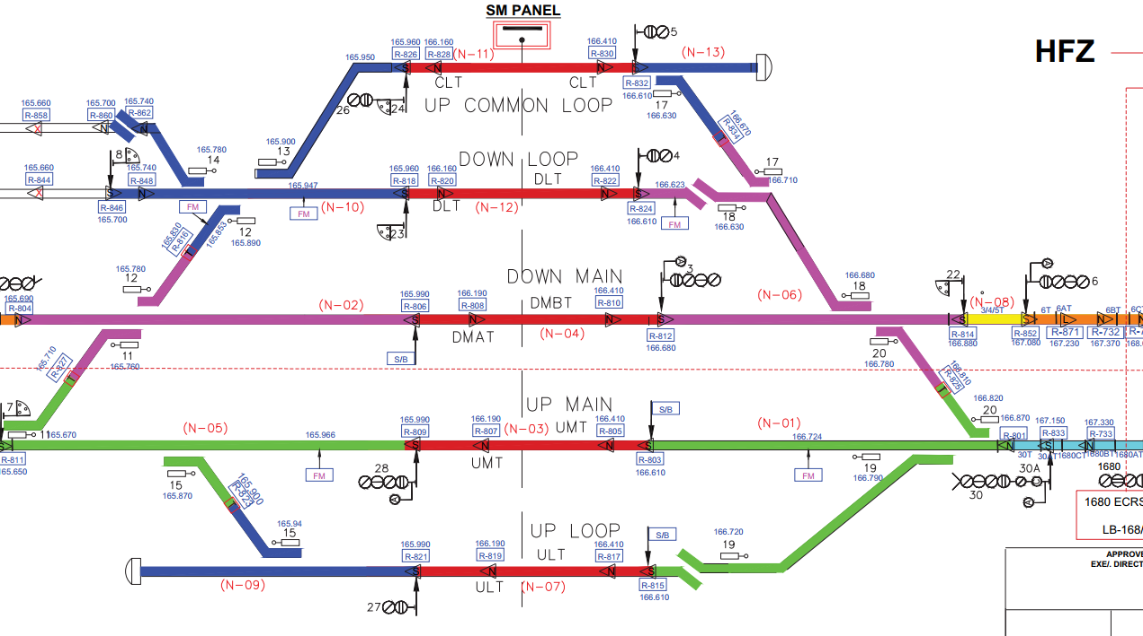
Track Identification Number (TIN)
Each Block section shall have single unique designated TIN. Each line in the station section having berthing portion shall have different TINs.
Each berthing track in the station shall have an unique TIN.

Slide 20
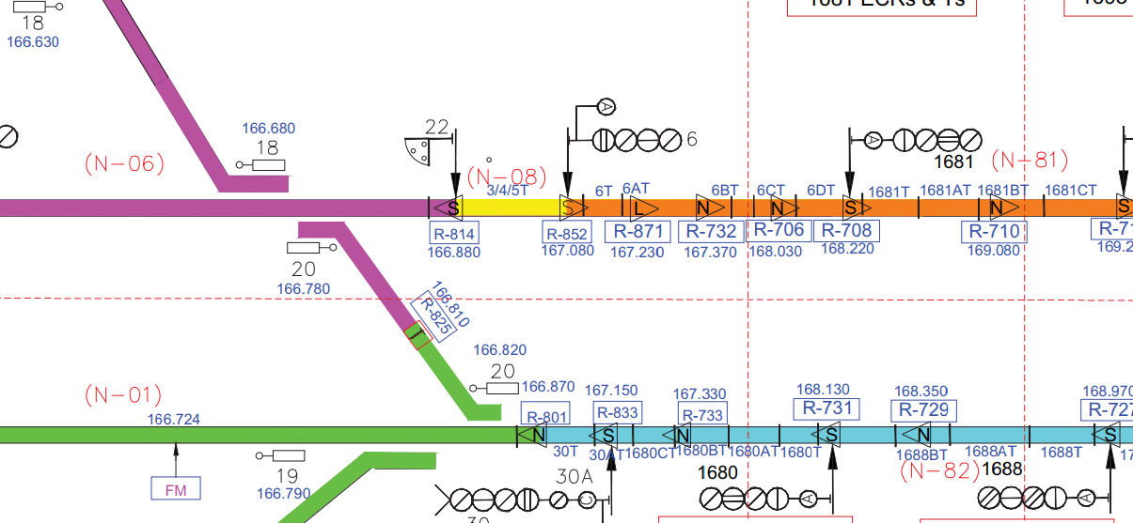

Track Identification Number (TIN)
Tag numbers (values in the range of 1 – 1023) and TIN numbers (values in the range of 1-255) shall be allotted by the user Railways. Sufficient spares for future needs shall be taken into consideration while allotting the numbers. The allotted numbers shall also be mentioned on the RFID tag-TIN layout.
For facilitating common loop reception when loco is standing between shunt signal and advance starter, TIN shall be bifurcated

Slide 21
Allocation of TINs :
TIN demarcation to be done at points joining the two Main lines. TIN demarcation to be done at points with overlap.

Slide 22
Allocation of TINs :
No TIN demarcation to be done at points without overlap

Slide 23
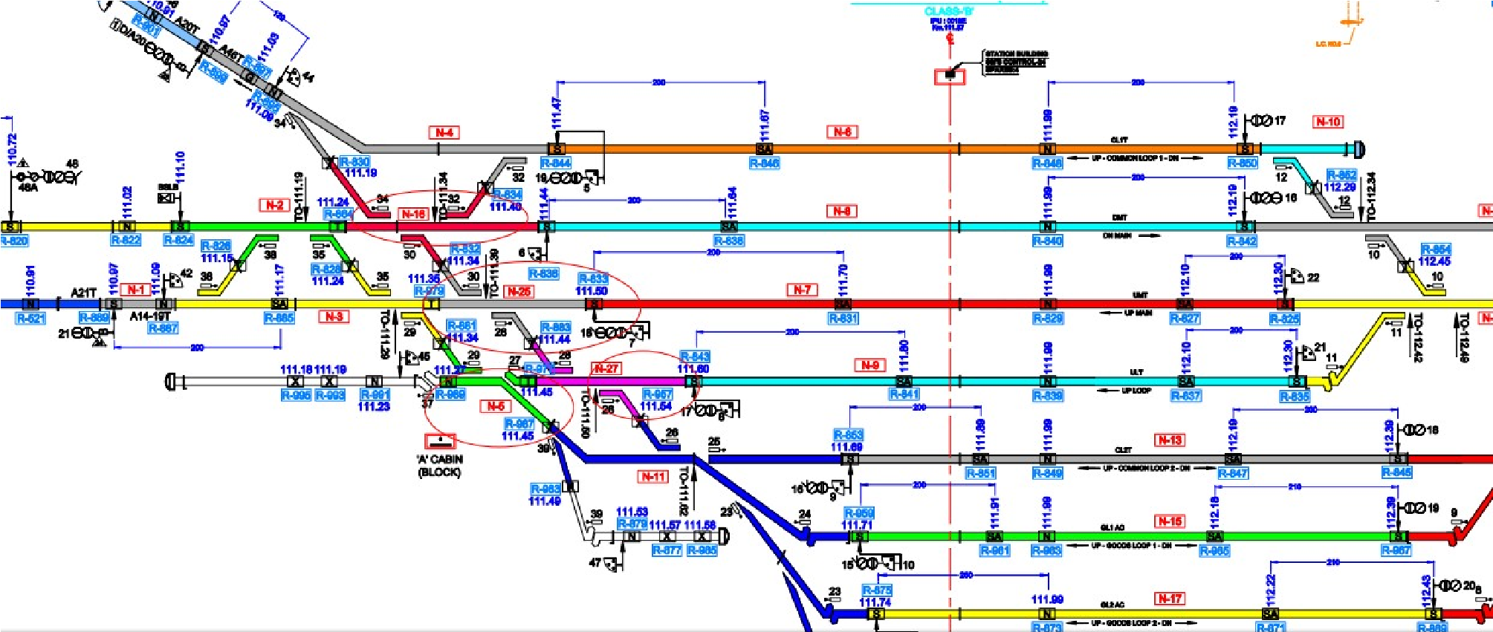
Allocation of TINs :
In cases where parallel movement is possible, TINs shall be assigned in such a way that movement in one line do not restrict movement along the other lines.

Slide 24
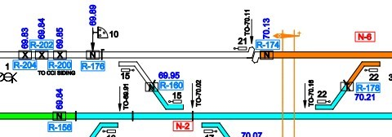
Allocation of TINs :
In cases where Exit tags are provided with two sets of Normal tags, TIN shall not be assigned up to the second Normal tag which marks the entry into TCAS territory.

Slide 25
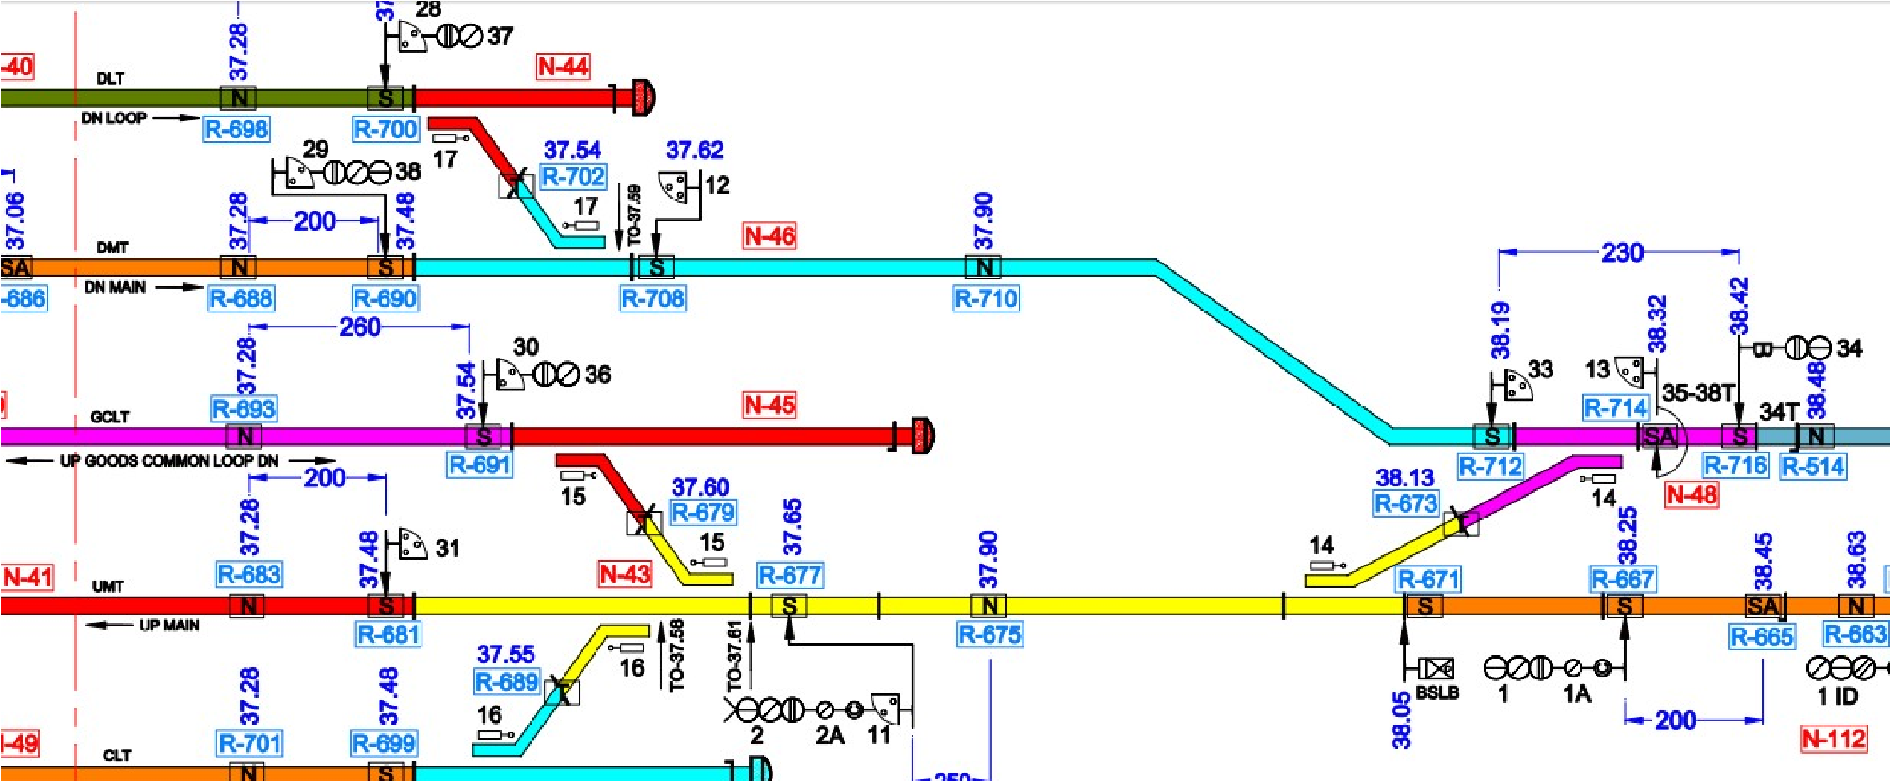
Allocation of TINs :
It shall be ensured that a Normal Tag is placed at a distance of 150m to 200m after Advance Starter in Double line and at a distance of 100m to 150m after Advance Starter in Single line which notifies the Loco TCAS about entry into Block section.

Slide 26
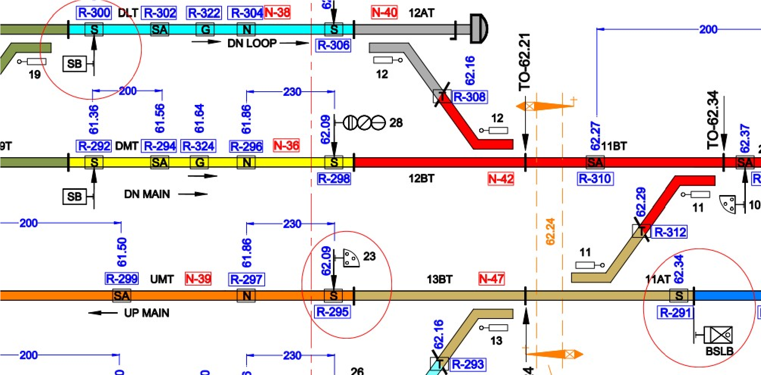
Allocation of TINs :
In addition to the signals, the permanent End of authority locations like Stop board, Block section limit board and end of berthing tracks(usually provided with shunt signals) are to be provided with Signal foot tag .

Slide 27
Role of RFID tags
If two consecutive Normal RFID tags are not read , either due to tags missing or due to any other reason, Loco TCAS shall switch from Full supervision mode to Limited supervision mode.
If Loco TCAS unit reads the TCAS exit tag (non-TCAS territory), it shall stop the radio communication and shall switch to Staff Responsible mode.
On start-up or restart, the Loco unit shall assume movement of direction as undefined. It shall be derived, when Loco/Train has passed two RFID tags with Absolute location.
If Absolute location value is incrementing, it shall be treated as Nominal direction. If Absolute location is decrementing, it shall be treated as Reverse direction.

Slide 28
Summary of RFID tags
Sl.No | Type of Tag | Function
1 | Normal Tag | The maximum distance between the two normal tags shall not be more than 1000m. Each Normal tag shall be linked to next two normal tags in both the directions
2 | Signal Foot Tag | To indicate the Signal Foot to the Approaching train If loco crosses this without MA, loco enters into Trip mode
3 | Signal Approach | At Signal approach, N tags shall be provided before the approach of (typically 150 ~ 250m) every signal post to correct the odometry error
4 | TIN Discrimination Tag | shall be used to indicate change in the TIN of track section. Normally it will be placed at turnouts.
5 | LC Gate Tag | shall be provided at both sides of LC gate at around 600 to 850 Mts
6 | Adjustment junction Tag | Shall be used to adjust the absolute location in the block section. Junction tag shall be provided, at the junction stations to correct the absolute location. Junction tag data shall not be used to determine the train direction movement such as Nominal or Reverse
7 | Exit Tags | shall be provided at TCAS territory exit point

Slide 29
QUIZ
Distance between Two normal tags incase of block section ?
RFID TAG used in KAVACH is Active type or Passive Type?
How many RFID Tags with identical information placed on track?
RFID Tags are Suitable for reliable working at train speed up to ?
Where Signal approach tags will be provided ?
Where TIN Discrimination tags will be provided ?
Where Gate tags Provided ?

Slide 30
धन्यवाद

